Slide 1
BI Analysis Week 5
Shawna Tuli (Shawna.tuli@avanade.com)

Slide 2
Agenda
Machine learning
Scikit-learn
Model evaluation

Slide 3
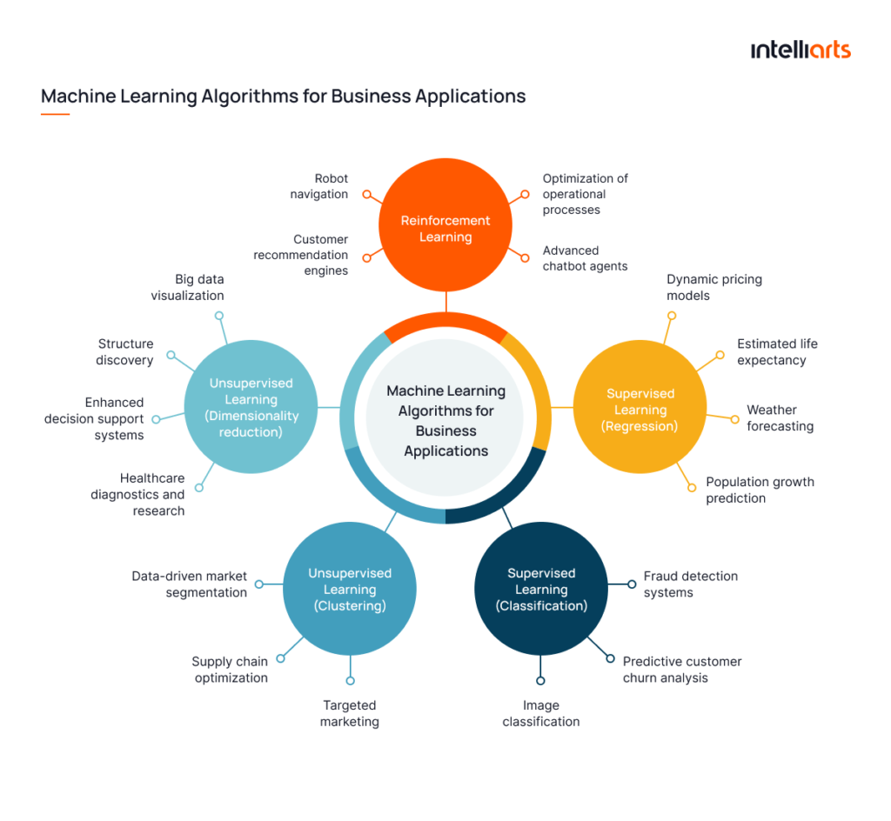
Machine Learning

Slide 4


Slide 5
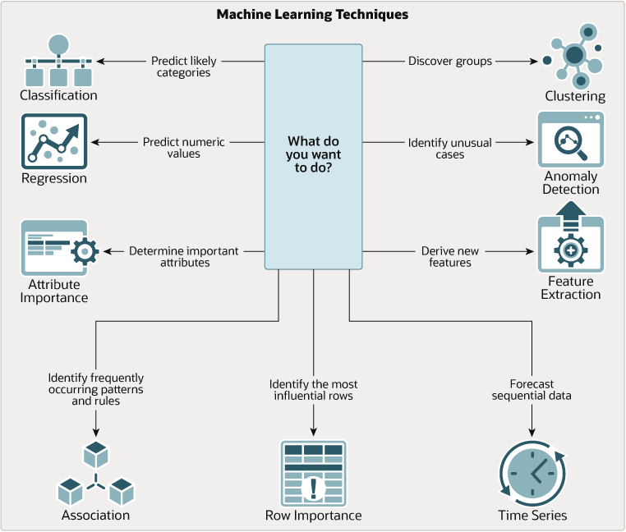

Slide 6
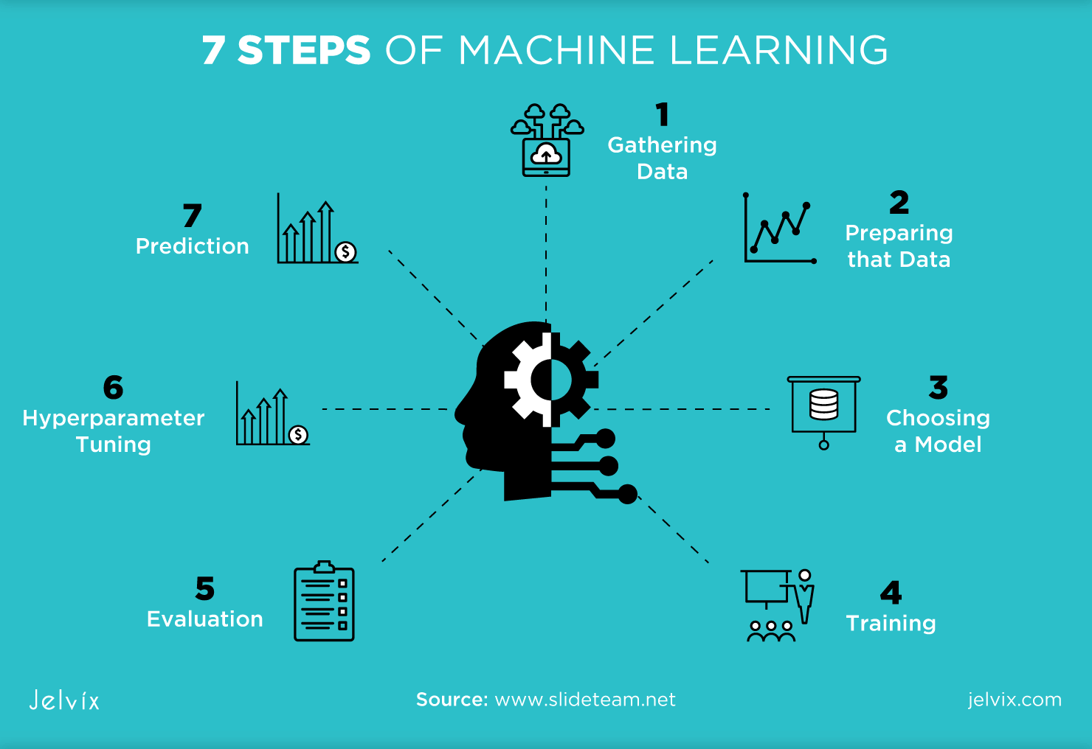

Slide 7
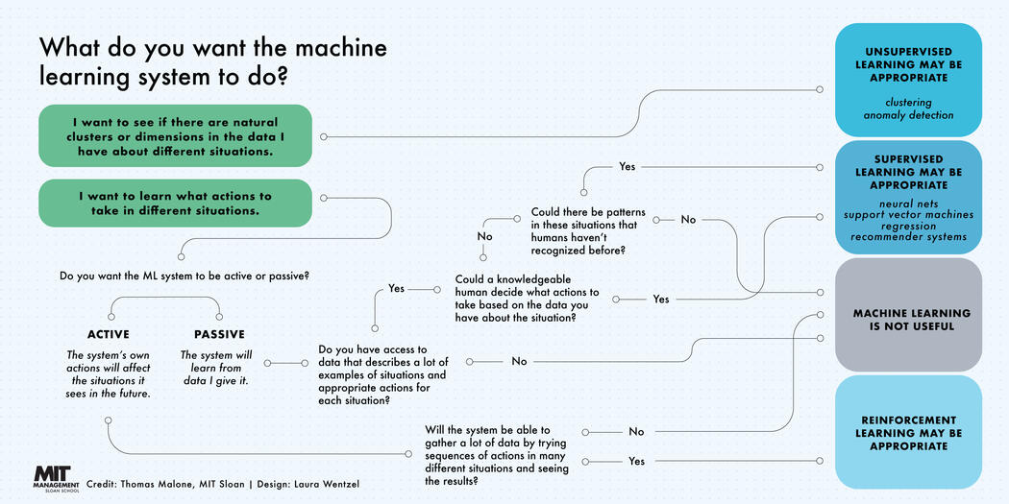

Slide 8
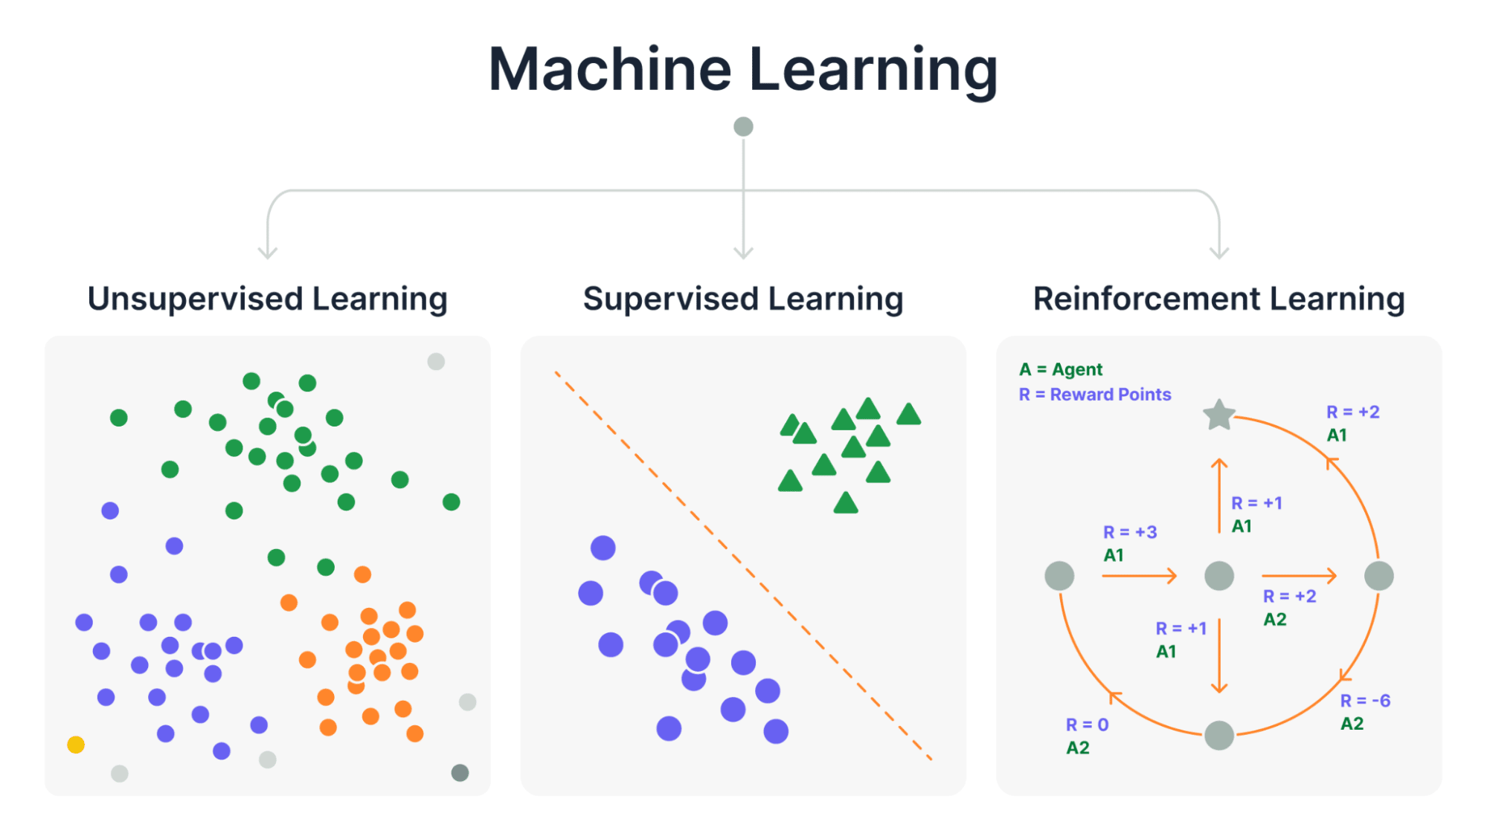

Slide 9
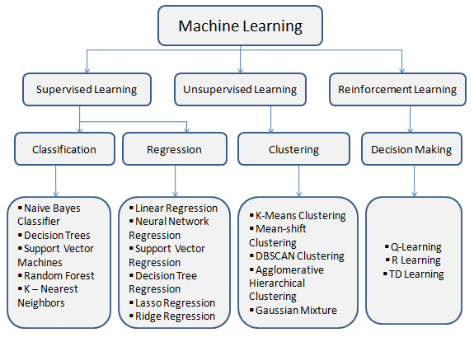

Slide 10
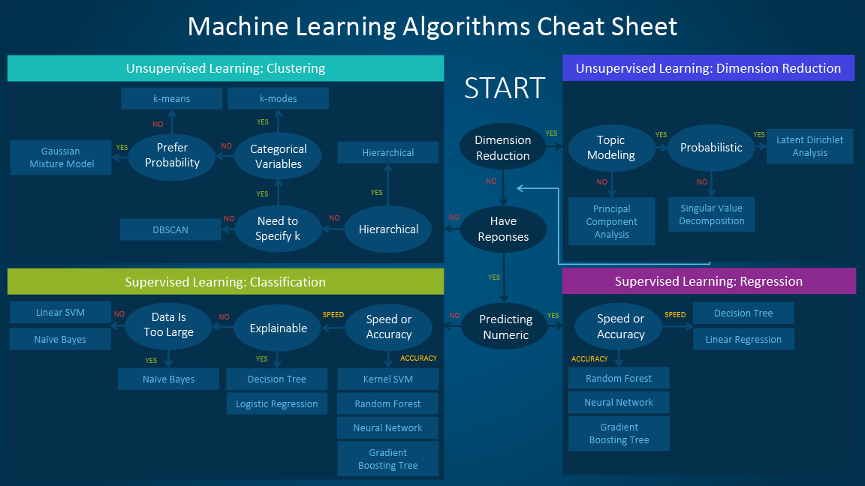

Slide 11
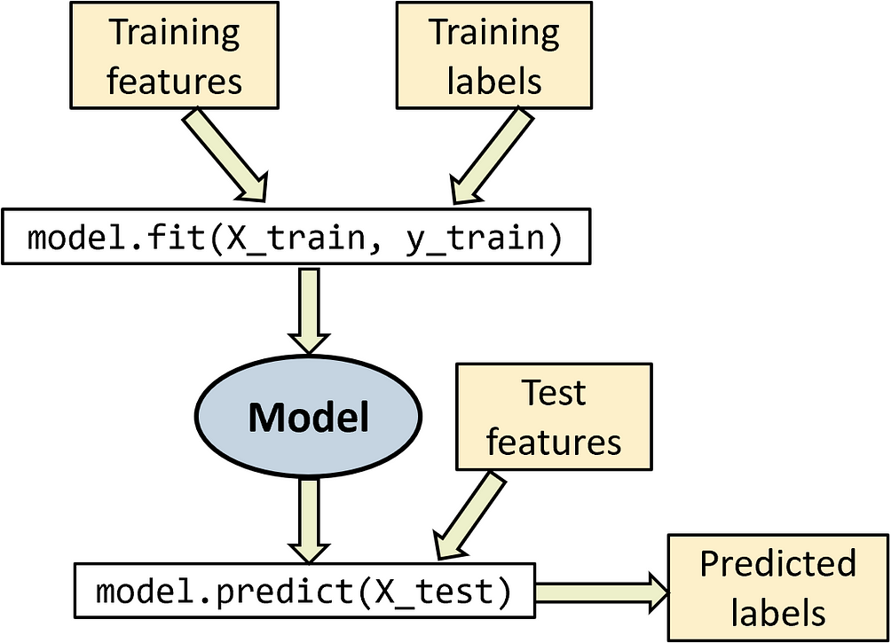
Scikit-Learn

Slide 12
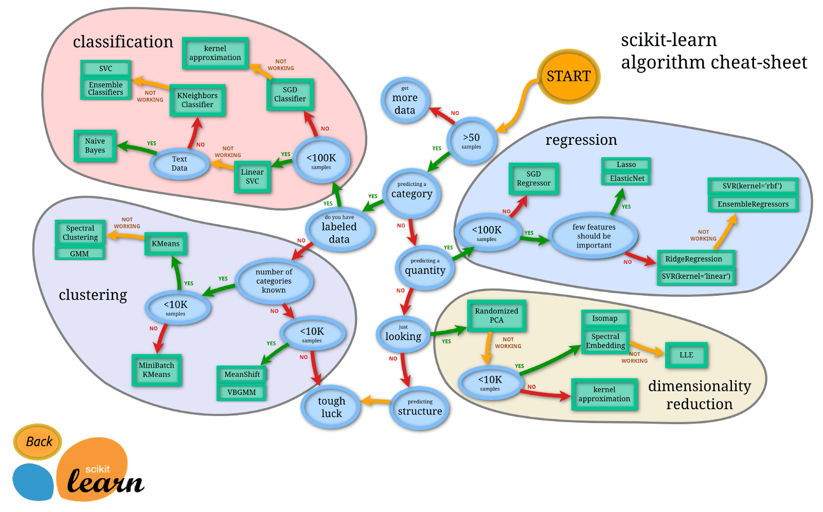

Slide 13
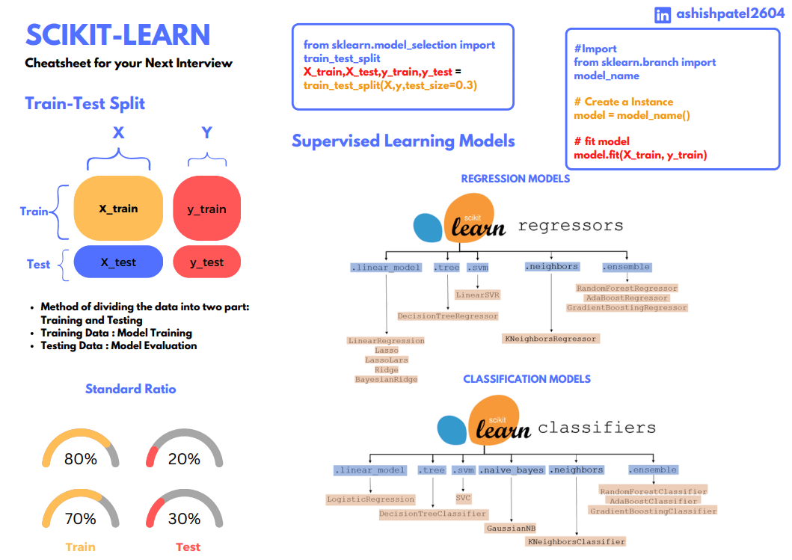

Slide 14
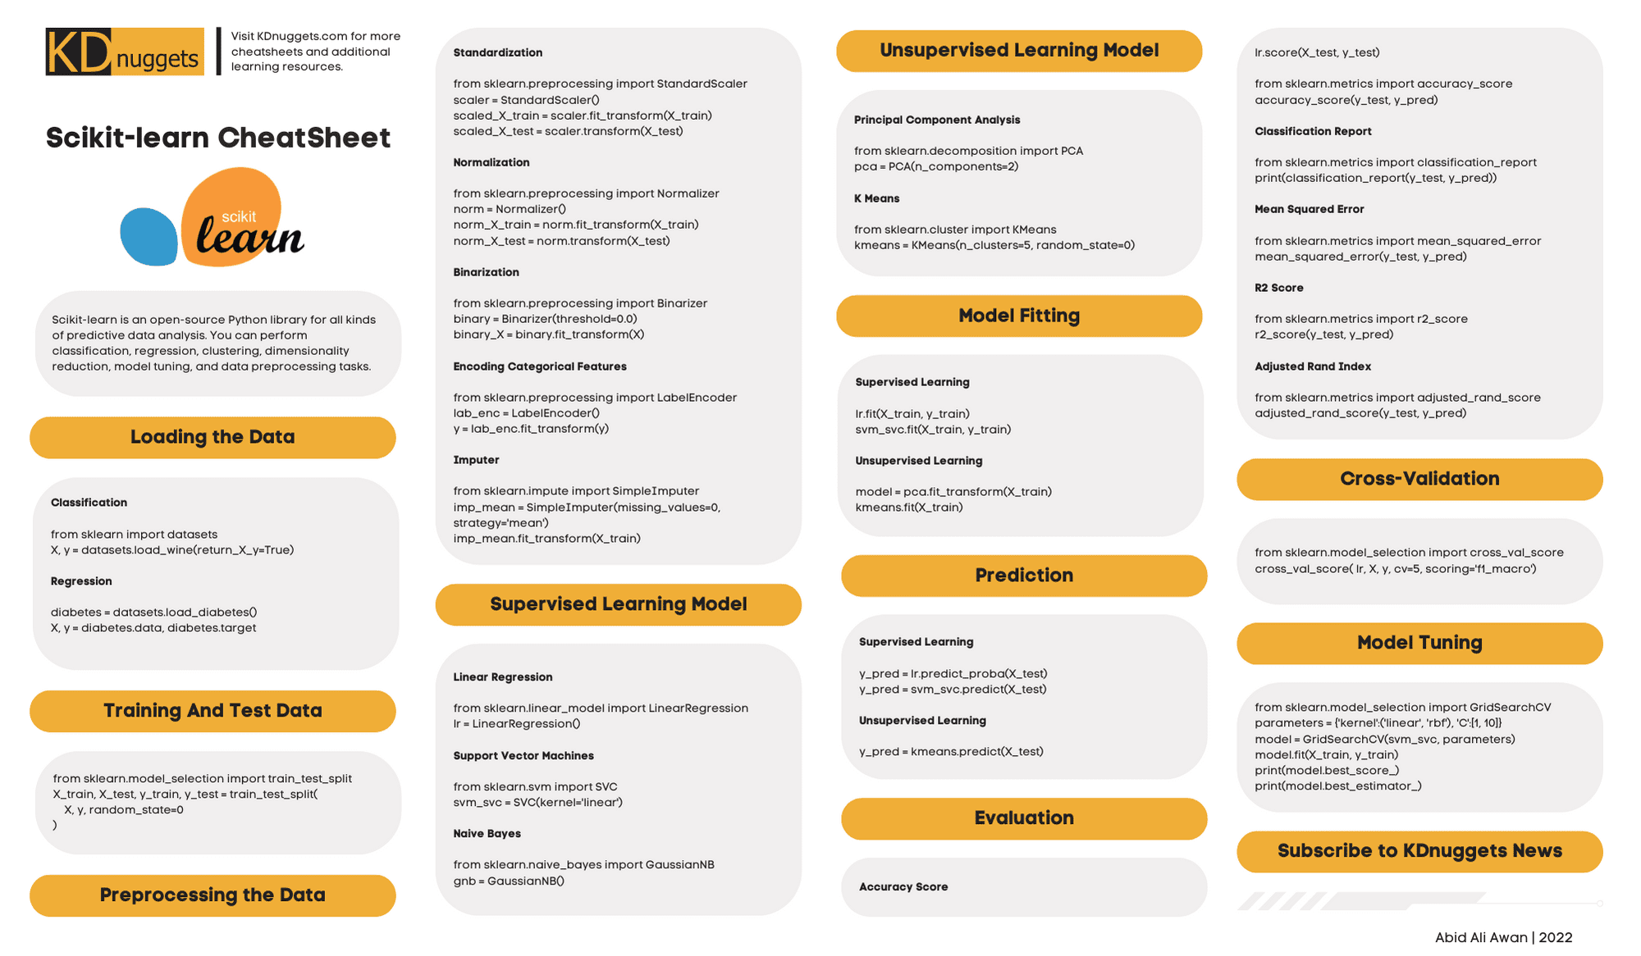

Slide 15
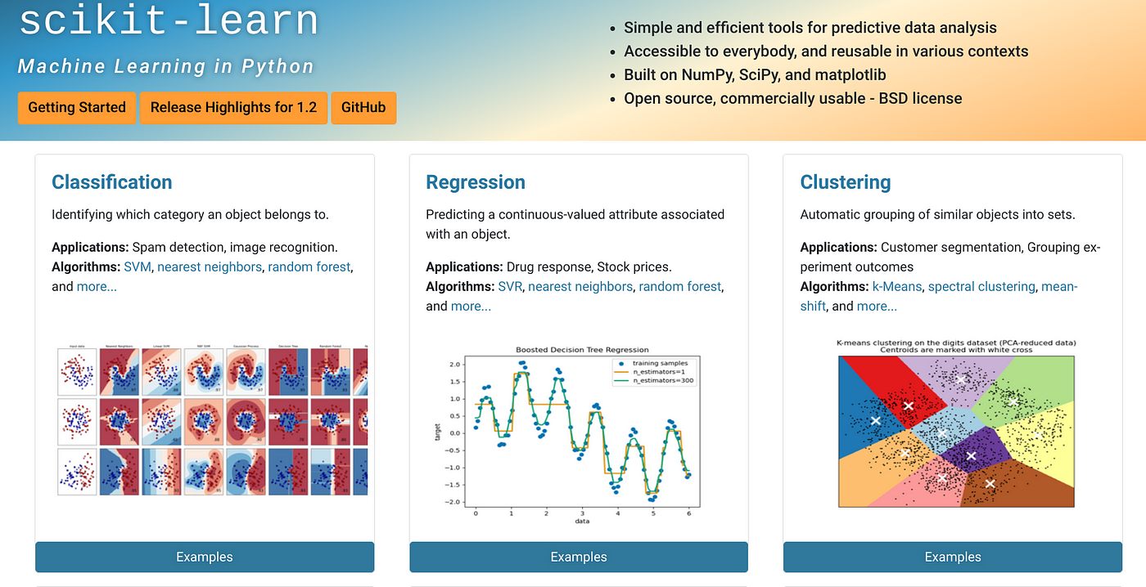

Slide 16
Model Evaluation

Slide 17
A Step-by-Step Guide to Model Evaluation in Python
Model evaluation is a crucial aspect of machine learning, allowing us to assess how well our models perform on unseen data. In this step-by-step guide, we will explore the process of model evaluation using Python. By following these steps and leveraging Python’s powerful libraries, you’ll gain valuable insights into your model’s performance and be able to make informed decisions. Let’s dive in and evaluate our machine learning models!
Step 1: Prepare the Data
The first step in model evaluation is to prepare your data. Split your dataset into training and test sets using the train_test_split function from the scikit-learn library. This ensures that we have separate data for training and evaluating our model.
from sklearn.model_selection import train_test_split # Split the data into training and test sets X_train, X_test, y_train, y_test = train_test_split(X, y, test_size=0.3, random_state=42)

Slide 18
Step 2: Train the Model
Next, select an appropriate model for your task and train it using the training set. For example, let’s train a logistic regression model using scikit-learn:
from sklearn.linear_model import LogisticRegression # Create an instance of the model model = LogisticRegression() # Train the model model.fit(X_train, y_train)
Step 3: Evaluate on the Test Set
Now, it’s time to evaluate our model on the test set. Use the trained model to make predictions on the test data and compare them to the actual labels. Calculate evaluation metrics such as accuracy_score to measure the model’s performance.

Slide 19
from sklearn.metrics import accuracy_score # Make predictions on the test set y_pred = model.predict(X_test) # Calculate accuracy accuracy = accuracy_score(y_test, y_pred) print("Accuracy:", accuracy)
Step 4: Perform Cross-Validation (Optional)
To obtain a more robust evaluation, you can perform cross-validation. This technique involves splitting the data into multiple folds and training/evaluating the model on different combinations. Here’s an example using cross_val_score from scikit-learn:
from sklearn.model_selection import cross_val_score # Perform cross-validation scores = cross_val_score(model, X, y, cv=5) # Calculate the average performance across all folds mean_accuracy = scores.mean() print("Mean Accuracy:", mean_accuracy)

Slide 20
Step 5: Assess Model’s Performance
Analyze the evaluation metrics obtained from the previous steps to assess the model’s performance. Consider the context of your problem and compare the results against your desired performance level or any baseline models. This analysis will provide insights into the strengths and weaknesses of your model.
Step 6: Iterate and Improve (if needed)
Based on the assessment, you may need to iterate and improve your model. Consider collecting more data, refining feature, trying different algorithms, or tuning hyperparameters. Repeat the evaluation process until you achieve the desired performance.
Conclusion:
Model evaluation is a critical step in machine learning that helps us understand how well our models perform. By following this step-by-step guide and utilizing the power of Python and its libraries, you can effectively evaluate and improve your machine learning models. Remember to experiment, iterate, and fine-tune your models to achieve the best possible performance.

Slide 21
Model Evaluation 2

Slide 22
1. Splitting the Data
Train-Test Split:
The first step is to split your dataset into a training set and a testing set. The training set is used to train the model, while the testing set is used to evaluate its performance.

Slide 23
2. Choosing Evaluation Metrics
Classification Metrics:
Accuracy: Measures the overall correctness of the model.
Precision: Measures the proportion of true positives among all positive predictions.
Recall: Measures the proportion of true positives among all actual positives.
F1-score: A harmonic mean of precision and recall, balancing both metrics.
ROC-AUC: A metric for evaluating the performance of a binary classification model across different thresholds.

Slide 24
2. Choosing Evaluation Metrics Continued
Regression Metrics:
Mean Squared Error (MSE): Measures the average squared difference between predicted and actual values.
Root Mean Squared Error (RMSE): The square root of MSE, providing an interpretable metric in the same unit as the target variable.
Mean Absolute Error (MAE): Measures the average absolute difference between predicted and actual values.
R-squared: Measures the proportion of the variance in the dependent variable that is predictable from the independent variables.

Slide 25
3. Evaluating the Model
Scikit-learn: Scikit-learn provides a wide range of evaluation metrics.

Slide 26
4. Cross-Validation
K-Fold Cross-Validation: To ensure more robust evaluation, you can use k-fold cross-validation, which splits the data into k folds, training the model on k-1 folds and evaluating on the remaining fold. This process is repeated k times, and the average performance is calculated.

Slide 27
5. Visualizing Model Performance
Confusion Matrix: For classification problems, a confusion matrix provides a detailed breakdown of the model's predictions.
ROC Curve: The ROC curve visualizes the trade-off between true positive rate and false positive rate.

Slide 28
6. Choosing the Best Model
Comparing Metrics: Compare the evaluation metrics of different models to choose the one that performs best for your specific problem.
Hyperparameter Tuning: Fine-tune the hyperparameters of your model to optimize its performance.

Slide 29
Timeline

Slide 30
Program
Kick-Off
Students will meet their teams and begin planning their project.
4 Workshops
Students will attend guided workshops covering key tools used in data science projects.
Help Sessions
Data@UCI will provide mini help sessions following the end each workshop.
Final Presentations
Groups will have the opportunity to present their projects and win prizes.

Slide 31
Week | Timeline
Week 1 (1/6-1/12) | Regular Event: Info Session for Mentees
Week 2 (1/13 - 1/19) | Regular Event : Project Kick-Off
Week 3 (1/20 - 1/26) | Thursday - Workshop 1: Tour of Notebooks/Environments/IDEs + Help Session
Week 4 (1/27-2/2) | Thursday - Workshop 2: Data Exploration (Pandas & Feature Selection) + Help Session
Week 5 (2/3 - 2/9) | Thursday - Workshop 3: Machine Learning (Scikit-Learn & Model Evaluation) + Help Session
Week 6 (2/10 - 2/16) | Thursday - Collaboration with Design@UCI (tentative + midterms)
Week 7 (2/17 - 2/21) | Thursday - Workshop 4: Data Visualization (Power BI or similar) + Help Session
Week 8 (2/24 - 3/1) | Thursday - Final Winter Project Help Session
Week 9 (3/3 - 3/9) | Thursday - Final Presentations

Slide 32
Deliverables

Slide 33
Week | Deliverable
Week 1 (1/6-1/12) | Commitment
Week 2 (1/13 - 1/19) | Meeting Series
Week 3 (1/20 - 1/26) | Jupyter Notebooks
Week 4 (1/27-2/2) | Exploratory Data Analyses
Week 5 (2/3 - 2/9) | Machine Learning
Week 6 (2/10 - 2/16) | Design
Week 7 (2/17 - 2/21) | Data Visualization
Week 8 (2/24 - 3/1) | Presentation
Week 9 (3/3 - 3/9) | Final Presentation

Slide 34
Thank you!

